Slide 1
P09 Player Selection 6th Presentation
A113 – Mathematics

Slide 2
Significance of Data
Data are measurements or records collected about a certain type of quantity or certain situation.
Example: Data collected on the heights of youths in Singapore.
Data are useful as they provide factual basis for us to make interpretation or draw conclusions about a certain type of quantity or situation that we are interested in.
Example:
Data collected | Situation
heights of youths in Singapore | Average height of youth in Singapore
educational qualifications of the residents in Singapore | Literacy Rate in Singapore
Make interpretations

Slide 3
Statistics and Data
Data are only as useful as the interpretations or conclusions we can draw from it. An organised set of data is useful for this purpose.
Statistics is the branch of knowledge that deals with how to effectively handle data to allow us to make interpretations or draw conclusions. It is widely used in different industries, e.g. insurance, finance, manufacturing, etc.
It consists namely of 3 stages namely, collecting, organising and analysing data.

Slide 4
Collecting data
Data collection allows us to gather inputs.
Generally, if we collect data from the entire population, our interpretation(s) and analysis would be very accurate. However, it is often unrealistic to do so, both in terms of time and resources.
We would usually collect data based on a smaller group, which is from the population. This is known as sampling.

Slide 5
Organising data
An organised set of data makes potential patterns, trends or interesting fact, which may be otherwise difficult to observe in a set of massive amount of data, more easily noticeable.
In the process of organising the data collected, it is useful to bear in mind three considerations, namely:
Relevancy
Grouping
Presenting

Slide 6
Organising data
Relevancy and Grouping reduces the amount of data clutter we need to work with. Identifying and using only relevant data addresses the consideration of Relevancy.
Grouping the data into groups of data known as classes becomes important when there are too many discrete values.
Example: In the measurement of heights, it may not be feasible to record many uniquely different heights. Instead, it may be useful to record the number of people who are tall, of average heights or are short.

Slide 7
Organising data
It is also common to use appropriate statistical tools or visuals to present the grouped data.
Some common statistical tools or visuals include:
tables,
bar chart,
pie chart,
line graph,
radar chart and
box-and-whisker plot
Selecting the appropriate visuals can enhance the ease of observing potential patterns, trends or interesting facts significantly.

Slide 8
Analysing data
In this stage, we make interpretations and draw conclusions from any observable pattern, trend or noticeably stable value(s) from the visuals/ charts we have created.
These interpretations or conclusions often becomes the basis for our decision(s), example: choosing a program or terminate an event etc.

Slide 9
Applying to today’s problem
For today’s problem, we are supposed to choose the best player to represent the school in the archery competition.
We know that the school has organised trials over 10 days.
Hence, we may use these data collected for us to find out some information about the situation.

Slide 10
Frequency table
A frequency table is a way of summarising a set of data.
It shows a set of possible outcomes and the number of times each outcome occurs.
Example:
Score Range | Frequency
311 to 315 | 4
316 to 320 | 16
321 to 325 | 25
326 to 330 | 19
331 to 335 | 6
336 to 340 | 0
341 to 345 | 0
346 to 350 | 0
351 to 355 | 0
356 to 360 | 0
The number of times that Andrew’s score fall within the range of 311 to 315 is 4.
Andrew’s scores:

Slide 11
Relative Frequency
Relative frequency can also be interpreted as the probability of the occurrence of a particular event.
Example:
Score Range | Frequency | Relative Frequency
311 to 315 | 4 | 4/70=2/35
316 to 320 | 16 | 16/70 =8/35
321 to 325 | 25 | 25/70=5/14
326 to 330 | 19 | 19/70
331 to 335 | 6 | 6/70=3/35
336 to 340 | 0 | 0
341 to 345 | 0 | 0
346 to 350 | 0 | 0
351 to 355 | 0 | 0
356 to 360 | 0 | 0
Andrew’s scores:
Sum of relative frequency / Total Probability
1

Slide 12
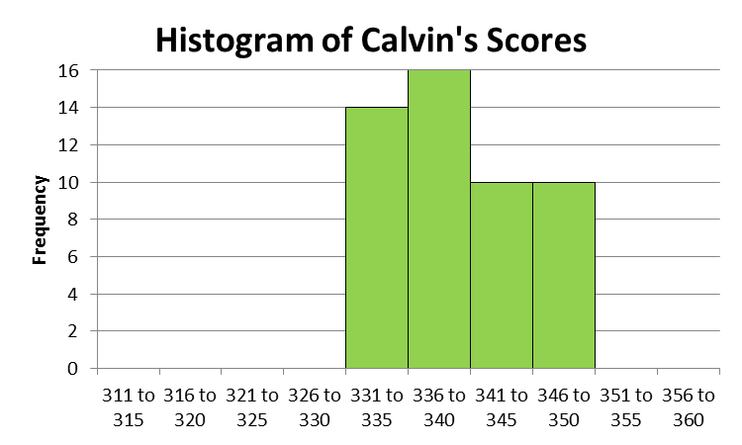
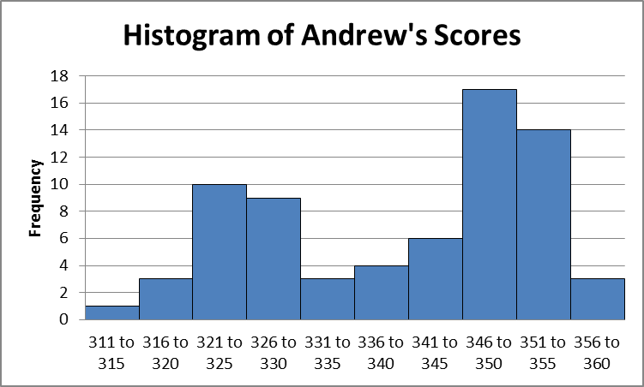
Histogram
The histogram is a graphical representation of a frequency table. It allows us to visualise the data.
The shape of the histogram gives us an idea of the distribution of the data.
Example:
Histogram of Dan’s Scores
Histogram of Bernard’s Scores
Mean of Dan’s scores = 339.7
Mean of Bernard’s scores = 340.1

Slide 13
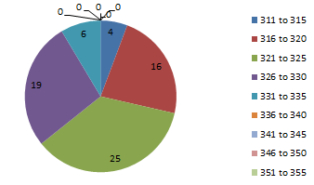
Pie Chart
A pie chart is divided into sectors, illustrating numerical proportion. In a pie chart, the arc length of each sector (and consequently its central angle and area), is proportional to the quantity it represents.
Pie Chart of Andrew’s scores
 | Andrew’s Scores
311 to 315 | 4
316 to 320 | 16
321 to 325 | 25
326 to 330 | 19
331 to 335 | 6
336 to 340 | 0
341 to 345 | 0
346 to 350 | 0
351 to 355 | 0
356 to 360 | 0

Slide 14
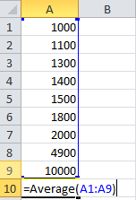
Mean
Mean is the average of a set of numerical values.
The function AVERAGE() in Excel can be used to find the mean of a set of values.
Example:
Emp1 | Emp2 | Emp3 | Emp4 | Emp5 | Emp6 | Emp7 | Emp8 | Emp9
$1,000 | $1,100 | $1,300 | $1,400 | $1,500 | $1,800 | $2,000 | $4,900 | $10,000
Mean

Slide 15
Median
Median is the number in the middle of a set of numerical values arranged in ascending or descending order.
For cases where extreme values exist, it is preferable to use the median because it is not affected by these extreme values, unlike the mean.
Example:
Median income
Emp1 | Emp2 | Emp3 | Emp4 | Emp5 | Emp6 | Emp7 | Emp8 | Emp9
$1,000 | $1,100 | $1,300 | $1,400 | $1,500 | $1,800 | $2,000 | $4,900 | $10,000
If there is an odd number of data points in a set, the median is exactly in the middle of the data.
Position Median= $1,500

Slide 16
Median
If there is an even number of data points in a set, the median is the average of the two middle numbers.
Example: Position of median
(i.e Average of the numbers at 4th and 5th Position)
Median
Two middle values
Emp1 | Emp2 | Emp3 | Emp4 | Emp5 | Emp6 | Emp7 | Emp8
$1,000 | $1,100 | $1,300 | $1,400 | $1,500 | $1,800 | $2,000 | $4,900

Slide 17
Mode
Mode is the number or a set of numbers that occurs the most often in a set of numerical values.
Mode is not commonly used to represent the data, because there could be more than one mode in any set of values.
Example: For the data below, the modes are $1,000 and $1,200 since they appear two times each compared to other values, which appear only once.
Occur most often
Occur most often
Emp1 | Emp2 | Emp3 | Emp4 | Emp5 | Emp6 | Emp7 | Emp8
$1,000 | $1,300 | $1,200 | $1,500 | $1,700 | $1,200 | $2,000 | $1,000

Slide 18
Spread of a data set
The mean, median and mode of a set of data do not always provide sufficient information for analysis. We can consider the spread of a data set in our analysis.
Standard deviation is a measure of how spread out your data is from the mean.

Slide 19
Standard deviation
A smaller standard deviation value will indicate that most of the data points are nearer to the mean (i.e. less spread out) as shown below.
Mean value of the respective players’ scores
Standard deviation of Dan’s scores = 5.13
Mean of Dan’s scores= 339.7
Standard deviation of Bernard’s scores = 12.30
Mean of Bernard’s scores = 340.13
Histogram of Dan’s Scores
Histogram of Bernard’s Scores
Dan‘s scores are not as spread out as Bernard’s scores.

Slide 20
Interpreting standard deviation
We may consider standard deviation as a measure of the spread of the data. A set of data that is less spread out will have a smaller standard deviation.
One might encounter the term variance when dealing with the spread of data. Variance is the square of standard deviation.

Slide 21
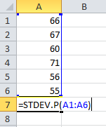
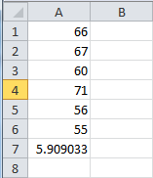
Using Excel to calculate standard deviation
The function STDEV.P() in Excel can be used to find the standard deviation of a set of values. Example:

Slide 22
Selection of player
The mean and variance of the players’ scores are shown below:
Though the mean of Bernard’s score is the highest, its variance is the worst. This means that Bernard can score very well on one occasion and very poorly on another.
On the other hand, the spread of Andrew’s score is the lowest but the mean of his scores is the worst.
 | Andrew | Bernard | Calvin | Dan
Mean | 323.63 | 340.13 | 334.76 | 339.7
Variance | 25.32 | 151.23 | 58.06 | 26.30

Slide 23
Selection of player
A suitable representative would be Dan as the mean of his scores is the 2nd highest and the spread of his scores is very close to Andrew’s who has the lowest spread.
Other factors such as the player’s commitment, passion, number of times taking part in competition, number of years in experience and being able to perform under pressure can be considered.

Slide 24
Worked Example (Practice Question Q5)
The weights of 9 students are recorded in the table below:
Mean weight of these 9 students
kg
Student | Weight (kg)
A | 39.9
B | 31.3
C | 33.9
D | 38.7
E | 39.9
F | 32.8
G | 37.9
H | 33.9
I | 36.6
The modes are 33.9 kg and 39.9 kg as these weights occur twice each in the table, while the other values occur only once.

Slide 25
Worked Example (Practice Question Q5)
If the table is amended to include the weight of Student J, the mean weight of these 10 students will be 36.4 kg. What is the weight of Student J?
Total weight of these 10 students = 36.4 × 10
= 364 kg
The total weight of the first 9 students was 324.9 kg
Weight of Student J = 364 – 324.9
= 39.1 kg

Slide 26
Worked Example (Practice Question Q8)
The table shows the income for part-time work done by 100 students.
Income for part-time work done ($) | $150 | $160 | $175 | $185 | $190 | $210 | $220 | $230 | $250
Frequency | 10 | 8 | 12 | 8 | 13 | 21 | 18 | 7 | 3
The relative frequency of students who earned $230 b) Mode(s) of the income for this group of students is $210 as $210 corresponds to the highest frequency. c) Median income for this group of students is $190. (We work out the position of the median by taking the total number of students to give us the middle position of 50.5. Next, count all frequencies from the left (10+8+12+8+13=51) so median is $190. d) The mean income for this group of students is

Slide 27
Learning Objectives
Recognise that statistics is the study of handling data effectively for the purpose of drawing information such as trend or pattern from the data about the situation.
Recognise that the following types of statistical tools and charts are available to represent and visualise data: tables, bar chart, pie chart, line graph
Use table, bar chart and pie chart appropriately to organise, visualise and interpret data to support making of decision.
Represent data in appropriate tabular and graphical forms (e.g. frequency tables, histograms)
Determine and explain the appropriate use of mean, median and mode
Recognise and use standard deviation as a measure of the spread of data

Slide 28
Exploring Further
The range is the difference between each player’s highest and lowest score. Comparing the 4 players, we have:
Player | Range | Standard Deviation
Andrew | 20 | 5.03
Bernard | 42 | 12.3
Calvin | 30 | 7.62
Dan | 16 | 5.13
At a glance, the range seems to correspond to the standard deviation, i.e. high standard deviation has a large range and a low standard deviation has a smaller range.

Slide 29
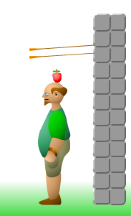

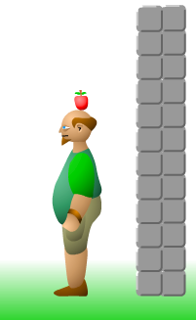
Exploring Further
However, the range is dependent on only the lowest and highest scores and does not take into account the difference each score is from the mean value.
Neither does it take into account how frequently the scores occur
Hence, the range can only be used as a quick preliminary gauge of the player’s performance.
Guess I’m Wrong….
Gosh…. Am I right?

Slide 30
Exploring Further
Edward’s scores have standard deviation of 4.97. This is a case where the range is large due to the extreme scores of 350 and 315. These scores did not occur frequently (not more than once) and based on the other scores, the standard deviation is still relatively low at 4.97.
In addition, Edward has a mean score of 338.5. By looking at the mean and standard deviation, it gives us a better idea of the player’s performance.
Edward’s performance is comparable to that of Dan’s.
Therefore, the coach’s comment is not justified.

